Slide 1
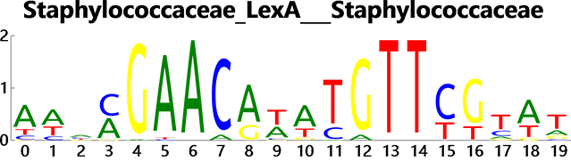
Raw Fasta Sequence
Build Model
1
2
Clustal
Multiple Alignment
MEME Suite
PWM
Not Strict:
Simply statics the residue
alphabet frequency
Logo Drawing Model

Slide 2
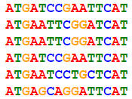
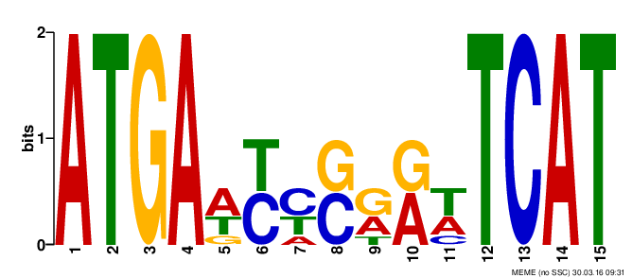
A
1 | 0 | 0 | 1 | 0.5 | 0 | 0.16 | 0 | 0.3 | 0.5 | 0.3 | 0 | 0 | 1 | 0 | 1
0 | 0 | 0 | 0 | 0 | 0.5 | 0.5 | 0.5 | 0 | 0 | 0.1 | 0 | 1 | 0 | 0 | 0
0 | 0 | 1 | 0 | 0.16 | 0 | 0 | 0.5 | 0.5 | 0.5 | 0 | 0 | 0 | 0 | 0 | 0
0 | 1 | 0 | 0 | 0.3 | 0.5 | 0.3 | 0 | 0.16 | 0 | 0.5 | 1 | 0 | 0 | 1 | 0
C
G
T

Slide 3


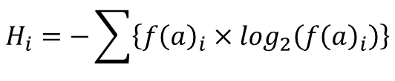
$${Bits}_{i}=\log_{2}\left(base\right)−\left(H_{i}+E\right)$$
$$E=\frac{1}{ln2}×\frac{base−1}{2×n}$$
$$H_{i}=−\sum{\left\{{f\left(a\right)}_{i}×\log_{2}\left({f\left(a\right)}_{i}\right)\right\}}$$

Slide 4
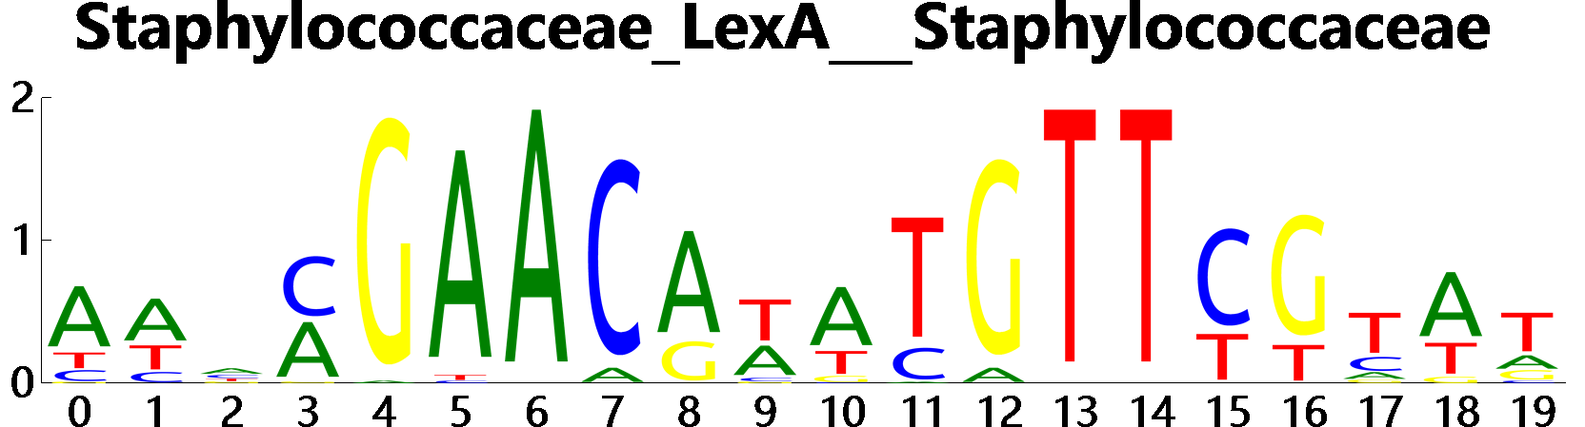
Bits
Residue Site i
DrawingModel

Slide 5
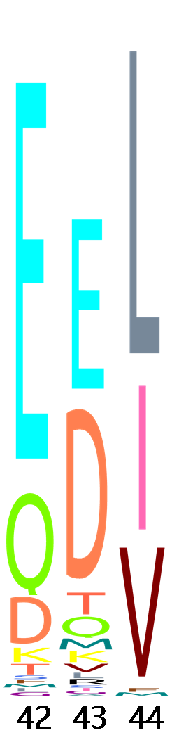



$$height={f\left(a\right)}_{i}×{Bits}_{i}$$
gdi.Gr_Device.DrawImage(
ColorSchema(Alphabet.Alphabet),
CSng(X), CSng(Y),
CSng(DrawingDevice.WordSize), H)
Y
X
Alphabet
in a residue site
$$height={f\left(a\right)}_{i}×{Bits}_{i}$$
H
DrawingDevice.WordSize
Residue

